Slide 1


Profit Margins
Hoby

Slide 2
Business Objective
Business Objective
Increase our overall profit margin to 70%
Strategic Objectives
Improve individual product profit margins
- Reduce costs
KPI
KPI
KPI
Gross Profit Margin per Year
Top/bottom product profit margins
Gross Profit increase from last year

Slide 3
Overview
3
2
Item Profit Margins
Profit Margins per Quarter
Sub-Categories
Recommendations
4
1

Slide 4
Assumptions
Assumption 2:
Total revenue considers coupons
?
?
Assumption 1:
The customer pays the shipping fees
?
Assumption 3:
?
?
Cost of Goods Sold = quantity * cost of item

Slide 5
3 Key Takeaways
Recent Dip in Profit Margin was 1% point in 2022 Q4
Gross Profit Increased 30% From 2021 - 2022
Our Most Profitable Item is T-Shirts

Slide 6
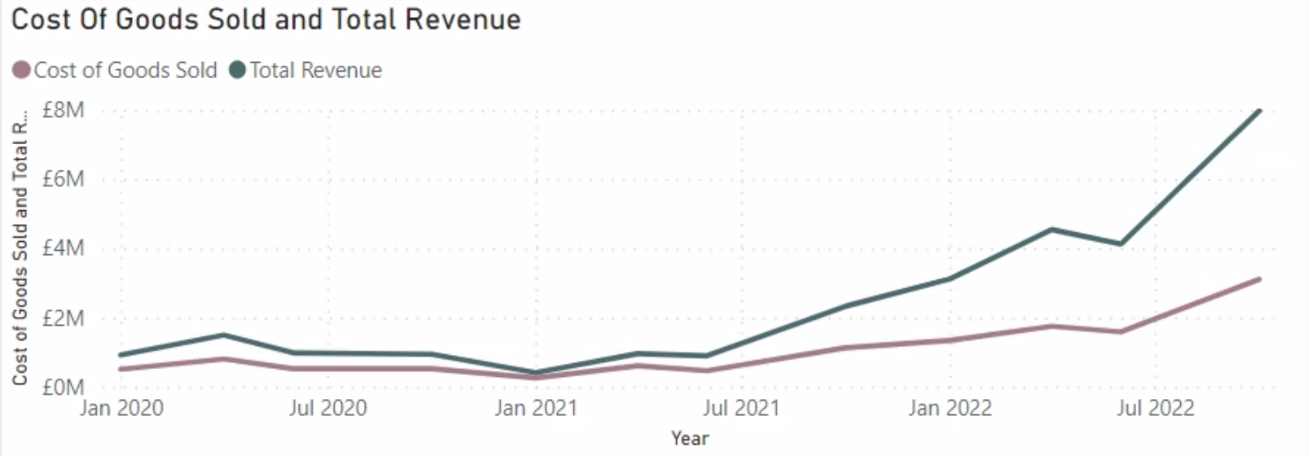
Revenue Vs Costs of Goods
Since July 2021, the difference between revenue and costs (gross profit) has been steadily increasing
We can see a dip in 2022 around the time Prism was acquired
Recently seen a boom in revenue of around 50%.

Slide 7
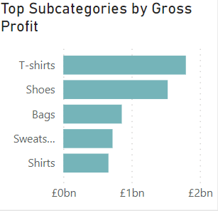
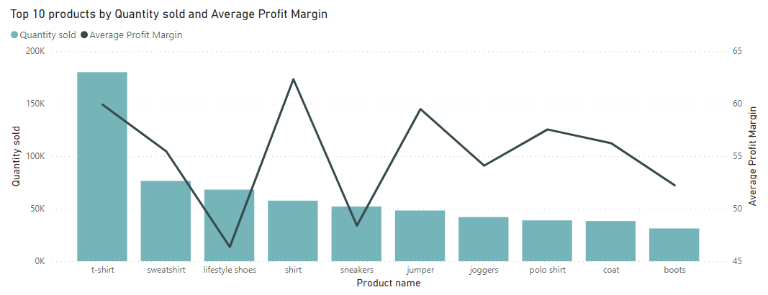
Where Does The Revenue Come From?
T-shirts and Shoes produce more Gross Profit in comparison to other sub- categories
‘T-shirt’ is our top selling item, as well as having a high profit margin
Shirts and jumpers also have high profit margins
Despite selling well, shoes have a lower profit margin
Recommendations:
Market the most profitable items more, to try and increase quantity sold
Decrease the cost of shoes, to increase their profit margin

Slide 8

Gross Profit Margin of Products
Highest Profit Margin
Lowest Profit Margin
Top 1
Lowest 1
z
80%
Gift-Wrap
24%
Kitchen Knife
3

Slide 9
Recommendations
These are some of the recommendations we suggest to help increase profit margins
1.
$$$
Discontinue low profit margin items
2.
Negotiate with current and potential suppliers to reduce item cost
5.
%
3.
Implement Marginal Gains Theory
Implement Economies of Scale
4.
4
Bundling

Slide 10
?
Questions

